Slide 1



Software engineering (Undergraduate)
Chapter 5 Finalizing Requirements Development
Course Name software requirement engineering
CSC 4126
(Undergraduate)
M. Mahmudul hasan
Assistant Professor, CS, AIUB
http://www.dit.hua.gr/~m.hasan

Slide 2
Purposes of Prototypes
MMH
Slide-2
Clarify, complete, and validate requirements
Explore design alternatives
Create a subset that will grow into the ultimate product

Slide 3
Paper Prototypes
MMH
Slide-3
A paper prototype is a cheap, fast, and low-tech way to explore how a portion of an implemented system might look
helps to test whether users and developers hold a shared understanding of the requirements
involve tools no more sophisticated than paper, index cards, sticky notes, and whiteboards
facilitates rapid iteration, and iteration is a key success factor in requirements development
is an excellent technique for refining the requirements prior to designing detailed user interfaces, constructing an evolutionary prototype, or undertaking traditional design and construction activities
It also helps the development team manage customer expectations

Slide 4
Mock-ups
MMH
Slide-4
A mock-up is also called a horizontal prototype (User interface Design)
Such a prototype focuses on a portion of the user interface; it doesn’t design into all the architectural layers or into detailed functionality
This type of prototype lets you explore some specific behaviours of the intended system, with the goal of refining the requirements
User Interface (UI) – how the software looks (colour, font size, etc.)
User Experience (UX) – how easy it is to the user to use (e.g. it is easier to find login function in the top right corner as we are familiar with other software)

Slide 5
Mock-ups
MMH
Slide-5
The mock-up helps users judge whether a system based on the prototype will let them do their job in a reasonable way
A mock-up implies behaviour without actually implementing it
Mock-ups can demonstrate the functional options the user will have available, the look and feel of the user interface (colours, layout, graphics, controls), and the navigation structure
When working with a throwaway mock-up prototype, the user should focus on broad requirements and workflow issues without becoming distracted by the precise appearance of screen elements

Slide 6
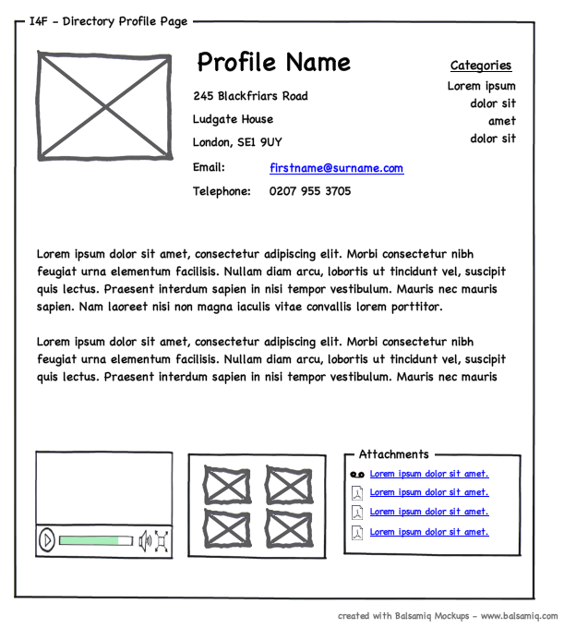
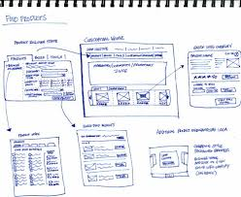
Wireframe
Slide-6
MMH
A wireframe is a particular approach to throwaway prototyping commonly used for custom user interface design and website design
A better understanding of three aspects of a website:
The conceptual requirements (are used to understand a subject matter, is useful for working with users to understand the types of activities they might want to perform at the screen)
The information architecture or navigation design
The high-resolution, detailed design of the pages

Slide 7
proofs of concept
MMH
Slide-7
A proof of concept is also known as a vertical prototype (architecture design)
Implements a slice of application functionality from the user interface through all the technical services layers
A proof-of-concept prototype works like the real system is supposed to work because it touches on all levels of the system implementation

Slide 8
Throwaway vs. Evolutionary
MMH
Slide-8

Slide 9
Classes of Prototype Attributes
MMH
Slide-9
Scope
A mock-up prototype (sample functionality) focuses on the user experience; a proof-of-concept prototype explores the technical soundness of a proposed approach (e.g. ATM)
Future use
A throwaway prototype is discarded after it has been used to generate feedback, whereas an evolutionary prototype grows into the final product through a series of iterations
Form
A paper prototype is a simple sketch drawn on paper, a whiteboard, or in a drawing tool. An electronic prototype consists of working software for just part of the solution

Slide 10
Possible ways of incorporating prototypes into SDLC
MMH
Slide-10

Slide 11
Working with prototypes
MMH
Slide-11
Dialog Map is a user interface modelled in the form of a state-transition diagram representing different interaction and navigation map (page 235-237)

Slide 12
Risks of prototyping
MMH
Slide-12
Pressure to release the prototype
Distraction by details (user becomes obsessed, not cover all the options user wanted)
Unrealistic performance expectations
Investing excessive effort in prototypes

Slide 13
Prototyping success factors
Slide-13
MMH
Include prototyping tasks in your project plan. Schedule time and resources to develop, evaluate, and modify the prototypes
State purpose of each prototype before you build it, and explain what will happen with outcome: either discard (or archive) the prototype, retaining the knowledge it provided, or build upon it to grow it into the ultimate solution
Plan to develop multiple prototypes. You’ll rarely get them right on the first try, which is the whole point of prototyping
Create throwaway prototypes as quickly and cheaply as possible. Invest the minimum amount of effort that will answer questions or resolve requirements uncertainties
Don’t prototype requirements that you already understand, except to explore design alternatives
Don’t expect a prototype to replace written requirements

Slide 14
Why prioritize requirements?
MMH
Slide-14
When customer expectations are high and timelines are short, you need to make sure the product delivers the most critical or valuable functionality as early as possible
Prioritization is a way to deal with competing demands for limited resources

Slide 15
prioritization pragmatics
MMH
Slide-15
Successful prioritization requires an understanding of six issues:
The needs of the customers
The relative importance of requirements to the customers
The timing at which capabilities need to be delivered
Requirements that serve as predecessors for other requirements
Which requirements must be implemented as a group
The cost to satisfy each requirement (hard/soft satisfaction)

Slide 16
prioritization techniques
MMH
Slide-16
In or out
The simplest of all prioritization methods is to have a group of stakeholders work down a list of requirements and make a binary decision: is it in, or is it out?
Pairwise comparison and rank ordering
People sometimes try to assign a unique priority sequence number to each requirement
Rank ordering a list of requirements involves making pairwise comparisons between all of them so you can judge which member of each pair has higher priority

Slide 17
prioritization techniques
MMH
Slide-17
The four capitalized letters in the MoSCoW prioritization scheme stand for four possible priority classifications for the requirements in a set:
Must: the requirement must be satisfied for the solution to be considered a success
Should: the requirement is important and should be included in the solution if possible, but it’s not mandatory to success
Could: it’s a desirable capability, but one that could be deferred or eliminated. Implement it only if time and resources permit
Won’t: this indicates a requirement that will not be implemented at this time but could be included in a future release

Slide 18
prioritization techniques
MMH
Slide-18
Three-level scale
High-priority requirements are both important (customers need the capability) and urgent (customers need it in the next release)
Medium-priority requirements are important (customers need the capability) but not urgent (they can wait for a later release)
Low-priority requirements are neither important (customers can live without the capability if necessary) nor urgent (customers can wait, perhaps forever)
Importance of Requirements
Urgency of Requirements | Low/Low | Medium/Low | High/Low
 | Low/Medium | Medium/Medium | High/Medium
 | Low/High | Medium/High | High/High

Slide 19
Multipass prioritization
MMH
Slide-19
When performing a prioritization analysis with the three-level scale, you need to be aware of requirement dependencies
You’ll run into problems if a high-priority requirement is dependent on another that is ranked lower in priority and hence planned for implementation later on

Slide 20
Prioritization : Resource Allocation
MMH
Slide-20
Prioritization is about thoughtfully allocating limited resources to achieve the maximum benefit from the investment an organization makes in a project.
One way to make prioritization more tangible is to cast it in terms of an actual resource: money, in this case, it’s just play with money.

Slide 21
Example of $100 in prioritization
MMH
Slide-21
Give the prioritization team 100 imaginary dollars to work with.
Team members allocate these dollars to “buy” items that they would like to have implemented from the complete set of candidate requirements.
They weight the higher-priority requirements more heavily by allocating more dollars to them.
If one requirement is three times as important to a stakeholder as another requirement, she would assign perhaps nine dollars to the first requirement and three dollars to the second.
But 100 dollars is all the prioritizers get—when they are out of money, nothing else can be implemented, at least not in the release they are currently focusing on.
One approach is to have different participants in the prioritization process perform their own dollar allocations, then add up the total number of dollars assigned to each requirement to see which ones collectively come out as having the highest priority.

Slide 22
Prioritization based on value, cost, and risk
Slide-22
Typical participants in the prioritization process include:
The project manager or business analyst who leads the process, arbitrates conflicts, and adjusts prioritization data received from the other participants if necessary
Customer representatives such as product champions, a product manager, or a product owner, who supply the benefit and penalty ratings
Development representatives who provide the cost and risk ratings

Slide 23
steps to use prioritization model
Slide-23
List in the spreadsheet all the features, use cases, user stories, or functional requirements that you want to prioritize against each other.
Have the customer representatives estimate the relative benefit each feature would provide to the customer or to the business on a scale of 1 to 9. A rating of 1 indicates that no one would find it useful; 9 means that it would be extremely valuable.
Estimate the relative penalty that the customer or the business would suffer if each feature were not included. Again, use a scale of 1 to 9. A rating of 1 means that no one will be upset if it’s absent; 9 indicates a serious downside. Requirements with both a low benefit and a low penalty add cost but little value.
The spreadsheet calculates the total value for each feature as the sum of its benefit and penalty scores.

Slide 24
steps to use prioritization model
Slide-24
Have developers estimate the relative cost of implementing each feature, again on a scale of 1 (quick and easy) to 9 (time-consuming and expensive). The spreadsheet will calculate the percentage of the total cost that each feature contributes.
Developers rate the relative technical (not business) risk associated with each feature on a scale of 1 to 9. Technical risk is the probability of not getting the feature right on the first try. A rating of 1 means you can program it in your sleep. A 9 indicates serious concerns about feasibility, the lack of necessary expertise on the team, the use of unfamiliar tools and technologies, or concern about the amount of complexity hidden within the requirement. The spreadsheet will calculate the percentage of the total risk that comes from each feature.
value% Priority = -------------- cost% + Risk %

Slide 25
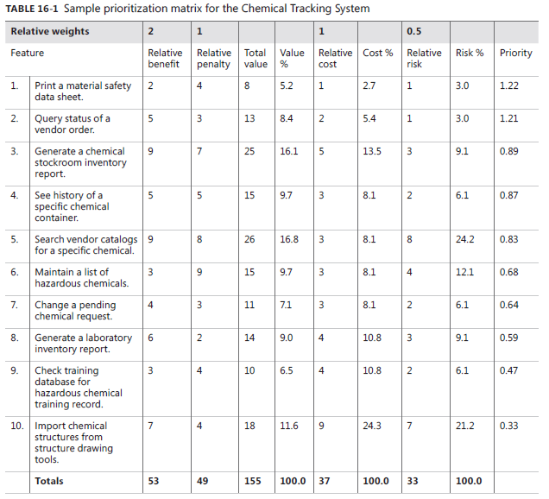
steps to use prioritization model (cntd.)
Slide-25
0.91
1.0
0.68

Slide 26
Validation and verification
Slide-26
Verification determines whether the product of some development activity meets its requirements (doing the thing right).
Validation assesses whether a product satisfies customer needs (doing the right thing). Requirements validation activities attempt to ensure that:
The software requirements accurately describe the intended system capabilities and properties that will satisfy the various stakeholders’ needs.
The software requirements are correctly derived from the business requirements, system requirements, business rules, and other sources.
The requirements are complete, feasible, and verifiable.
All requirements are necessary, and the entire set is sufficient to meet the business objectives.
All requirements representations are consistent with each other (no conflicts).
The requirements provide an adequate basis to proceed with design and construction.

Slide 27
Reviewing requirements
Slide-27
Informal review approaches include:
Peer desk check, in which you ask one colleague to look over your work product.
Pass around, in which you invite several colleagues to examine a deliverable concurrently.
Walkthrough, during which the author describes a deliverable and solicits (asks) comments on it.
Formal peer reviews follow a well-defined process. A formal requirements review produces a report that identifies the material examined, the reviewers, and the review team’s judgment as to whether the requirements are acceptable.
The best-established type of formal peer review is called an inspection. Inspection of requirements documents is one of the highest-leverage software quality techniques available.

Slide 28
The inspection process
Slide-28
Participants
The author of the work product and perhaps peers (similar competence) of the author (Analyst)
People who are the sources of information that fed into the item being inspected (Customer)
People who will do work based on the item being inspected (Developer)
People who are responsible for interfacing systems that will be affected by the item being inspected
Inspection roles
Author
Moderator
Reader
Recorder

Slide 29
The inspection process
Slide-29
Entry criteria
The document conforms to the standard template and doesn’t have obvious spelling, grammatical, or formatting issues (manuscript’s initial review).
Line numbers or other unique identifiers are printed on the document to facilitate referring to specific locations.
All open issues are marked as TBD (to be determined) or accessible in an issue-tracking tool.
The moderator didn’t find more than three major defects in a ten-minute examination of a representative sample of the document.

Slide 30
The inspection process
Slide-30
Inspection stages

Slide 31
The inspection process
Exit criteria
All issues raised during the inspection have been addressed.
Any changes made in the requirements and related work products were made correctly.
All open issues have been resolved, or each open issue’s resolution process, target date, and owner have been documented.

Slide 32
Defect checklist
Slide-32
MMH
Completeness
Do the requirements address all known customer or system needs?
Is any needed information missing? If so, is it identified as TBD?
Have algorithms inherently needed and specified to deliver the functional requirements?
Are all external h/w, s/w, and communication interfaces defined?
Is the expected behaviour documented for all anticipated error condition?
Do the requirements provide an adequate basis for design and test?
Is the implementation priority of each requirements included?
Is each requirements in scope for the project release, or iteration?
Is the requirements necessary for the product?

Slide 33
Defect checklist
Slide-33
MMH
Correctness
Do any requirements conflict with or duplicate other requirements?
Is each requirement written in clear, concise, unambiguous, and grammatically correct language?
Are any specified error messages clear and meaningful?
Are the requirements technically feasible and implementable within known constraints?
Quality Attributes
Are all the quality attributes objectives properly specified and documented also quantified with the acceptable trade-offs specified?
Are all the quality requirements measurable and verifiable?

Slide 34
Requirements review tips
Slide-34
Plan the examination – focus on specific section of document rather read the whole
Start early – detecting major defect early
Allocate sufficient time – specific hours in calendar time besides other tasks
Provide context – give reviewers context for the document if they are not working on the same project
Set review scope – tell reviewers what material to examine, where to focus their attention, and what issue to look for
Limit re-reviews – don’t ask anyone to review the same material more than three times
Prioritize review areas – prioritize for review those portions of the requirements that are of risk or have functionality that will be used frequently

Slide 35
Requirements review challenges
Slide-35
Large requirements documents
Large inspection teams
Geographically separated reviewers
Unprepared reviewers

Slide 36
Prototyping in requirements validation
Slide-36
Prototypes are validation tools that make the requirements real
All kinds of prototypes allow you to find missing requirements before more expensive activities like development and testing take place
Prototypes also help confirm that stakeholders have a shared understanding of the requirements
Proof-of-concept prototypes can demonstrate that the requirements are feasible

Slide 37
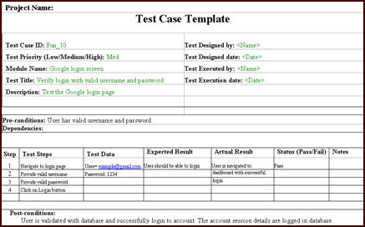
Testing The Requirements
Slide-37
Which is better? identify errors by RA vs. tester identify errors

Slide 38
Acceptance criteria
Slide-38
Specific high-priority functionality that must be present and operating properly before the product could be accepted and used
Essential non-functional criteria or quality metrics that must be satisfied
Remaining major open issues and defects are resolved
Specific legal, regulatory, or contractual conditions are fully satisfied
Supporting transition, infrastructure, or other project requirements (e.g. training materials) are available
ACCEPTANCE TESTS
Focus on testing the normal flows of the use cases and their corresponding exceptions, devoting less attention to the less frequently used alternative flows

Slide 39
USE of Requirements
Slide-39

Slide 40
Why reuse requirements?
Slide-40
Faster delivery & Higher team productivity
Fewer defects & Lower development costs
Reduced rework & Save review time
Accelerate the approval cycle
Speed up other project activities, such as testing
Improve your ability to estimate implementation effort if you have data available from implementing the same requirements on a previous project
Improve functional consistency across related members of a product line or among a set of business applications (a set of products in a family is called software product line)
Saves time for stakeholders, who then will not need to specify similar requirements repeatedly

Slide 41
Dimensions of requirements reuse
Slide-41
Extend of Reuse
Individual requirements statement
A set of requirements and their associated design, code, and test elements
Extent of Modification
Associated requirements attributes (priority, rationale, origin, etc.)
Related information (test, design, constraints, data definition, etc.)
Reuse Mechanism
Copy-and-paste from another specification
Copy from a library of reusable requirements

Slide 42
Requirement Evolution
Slide-42

Slide 43
Requirement patterns
Slide-43
Guidance of writing requirements (situation to which it is applicable)
Content of the requirements (details modifications)
Template of requirements (fill in the blanks)
Example (illustrative requirements of this type)
Consideration for development and testing (factors for developer/tester to keep in mind)

Slide 44
Reuse barriers
Slide-44
Missing or poor requirements
NIH and NAH:
NIH means “not invented here” – less effort need to write new requirements than to understand and fix existing generic requirements from other organizations.
NAH, or “not applicable here”
Writing style
Inconsistent organization – organize the requirements in different ways: product feature, process
Project type – requirements that are tightly coupled to specific implementation environment or platform
Ownership – copyright of intellectual properties of requirements in other system development

Slide 45
Reuse success factors
Slide-45
Repository
A single network folder that contains previous requirements documents
A collection of requirements stored in a requirements management tool that can be searched across projects
A database that stores sets of requirements selected from projects for their reuse potential and enhanced with keywords to help future BAs know their origin, judge their suitability, and learn about their limitations
Interactions – use traceability links in a tool to identify the dependencies of reusable requirements
Terminology – establish common terminology in reusing requirements
Organizational culture – encourage requirements reuse

Slide 46
References
MMH
Slide - 30
Wiegers, K., & Beatty, J. (2013). Software requirements. Pearson Education.
http://www.cs.ccsu.edu/~stan/classes/CS530/notes14/04-Requirements.html

